Slide 1

A New TABE for a New Era

Slide 2
TABE 11&12 Overview
  New national College- and Career-Readiness (CCR) Standards
  New test length
    Only one test length; no Survey and Complete Battery
  Reading, Math, and Language tests only
  Upper levels of TABE were designed to support a pathway to college readiness
    We are beginning our research study for the use of TABE and its equivalency to passing scores on ACT/Accuplacer
  TABE levels D and A targeted to support a pathway to HSE
    We are beginning our research study for the use of TABE and its equivalency to passing scores on TASC or other HSE tests
2
Notes:
TABE 11/12 is 100% aligned to the new College- and Career-Readiness Standards.
TABE 11/12 will be only one length; no longer will there be a long and short form. The new tests will be approximately 40 questions per section.
Math will also only be one test, not a separated Math Comp and Applied Math as TABE 9/10 has.
We are also lengthening (4 questions longer) the Locator test slightly to make it more predictive in placing students into the new TABE 11/12
TABE 11/12 will only have the 3 sections, Reading, Math and Language. There will not be the Spelling, Vocab and Language Mechanics that TABE 9/10 had.
TABE and TASC were developed by the same teams and share the same computer testing platform and are based on the same standards.

Slide 3
DRC Adult Assessments
TABE 9/10
  Paper or Computer-based (Insight)
  Federal approval expired June 30, 2019
TABE 11/12
  Paper or Computer-based (Insight)
  Federally-approved through June 30, 2024 for Reading, Math and Language
TABE CLAS-E
  Paper only (currently) Computer-based (Insight) expected in early 2020
  Federally-approved through June 30, 2021
  New NRS approval pending
3
Notes:
TABE 11/12 is 100% aligned to the new College- and Career-Readiness Standards.
TABE 11/12 will be only one length; no longer will there be a long and short form. The new tests will be approximately 40 questions per section.
Math will also only be one test, not a separated Math Comp and Applied Math as TABE 9/10 has.
We are also lengthening (4 questions longer) the Locator test slightly to make it more predictive in placing students into the new TABE 11/12
TABE 11/12 will only have the 3 sections, Reading, Math and Language. There will not be the Spelling, Vocab and Language Mechanics that TABE 9/10 had.
TABE and TASC were developed by the same teams and share the same computer testing platform and are based on the same standards.

Slide 4

TABE Partnerships
DRC Announces Partnership between the TABE Test and LiteracyPro Systems’ LACES to Provide Seamless Data Integration for Student Test Scores
Notes:
Not a key focus in Michigan since they use MAERS a state developed data system but just mention that like our partnership with LiteracyPro we are also working with Michigan to get data into MAERS directly.

Slide 5
TABE Resources
  Test Blueprints
  Practice Tests
  Order Forms
  Sample Score Reports
  News and Updates
  tabetest.com for all updates and info
5
Notes:
This is straightforward – TABE 9/10 continues to be approved. The US Dept of Ed has told states they can use 9/10 until June 30, 2019 if needed.
FOR BULLET #3 add your states information on when TABE 11/12 is allow to be used and if your state has set a 9/10 cut off.
Your state might not use CLAS-E yet but just know all ESL test are in a holding pattern waiting for new NRS guidelines and final regulations. We will review CLAS-E and make any updates to the new College and Career Readiness Standards for ESL later this year.
If someone asks about adaptive testing - We would like to move towards Adaptive but more programs still use paper tests so we need to start with a new TABE 11/12 and then work on TABE Adaptive since there is a whole separate NRS process for adaptive tests.

Slide 6
TABE Best Practice Webinar Series
  Plan for 3rd Thursday of each month
  Each webinar will be recorded and posted to TABEtest.com
  Questions can be submitted via the chat window during the webinar
  Future topics can be suggested by emailing Mike Johnson: mjohnson@datarecognitioncorp.com
6
Notes:
Go to TABEtest.com to so the section under the Resource tab for the Webinars and all the Recordings. Mention that if they have not received any emails for the last 6 months of TABE Thursdays they should send Mike Johnson an email to be added to our email list.

Slide 7
TABE 11&12: Levels E/M/D/A Reading
  TABE 11&12 Reading content reflects mature, life- and work-related situations and highlights overlapping objectives, from word-meaning skills to critical-thinking skills
  These are measured using texts and forms familiar to everyday adult lives, as well as through excerpts that reflect our cultural diversity
  Based on OCTAE CCR standards focused largely on informational texts (e.g. research, scientific, historical information)
  The previous focus on literary text (e.g. fiction, memoir, poetry) is significantly decreased
7

Slide 8
TABE 11&12: Levels E/M/D/A Math
  TABE 11&12 Mathematics reflects math application, particularly routine tasks such as estimating quantities and making computations involving time, distance, weight, etc.
  Standards have more emphasis on applied versus computation skills
  Item sets are integrated by mathematical contexts appropriate for adults
  The objective distribution at Level A is very closely aligned with the content distribution of the TASC/HSE Mathematics test
8
Notes:
This slide main point is that math standards have changed and what was previously a Level D skill might now be a Level M skill.
Also there are more Applied skills at the higher levels due to the standards.
You can point out as an example that Level M will use a Protractor and Level D and A will use a scientific calculator while Level M uses a four function calculator and no calculator for Level E. All Calculators and Protractors are built in utilities in Insight

Slide 9
TABE 11&12: Levels E/M/D/A Language
  The goal of adult language instruction is to build communication skills necessary for functioning effectively on the job and in daily life
  TABE Language assesses skills in grammar, usage, mechanics, sentence formation, and paragraph development. Understanding of word meaning and relationships, context, spelling, capitalization and punctuation in sentences, phrases, and clauses is included
  Items are presented in meaningful contexts that reflect the writing process as it is applied in life
9
Notes:
Key point here is to point out in bullet 1 that there are spelling and language mechanic skills included that were not part of TABE 9/10 Language.

Slide 10
NRS Changes
Example: NRS Level 1 Math
Old:
Individual has little or no recognition of numbers or simple counting skills or may have only minimal skills, such as the ability to add or subtract single digit numbers.
Students prepared to exit this level are able to decipher a simple problem presented in a context and reason about and apply correct units to the results. They can visualize a situation using manipulatives or drawings and explain their processes and results using mathematical terms and symbols appropriate for the level. They recognize errors in the work and reasoning of others. They are able to strategically select and use appropriate tools to aid in their work, such as pencil/paper, measuring devices, and/or manipulatives. They can see patterns and structure in sets of numbers and geometric shapes and use those insights to work more efficiently.
Number Sense and Operations: Students prepared to exit this level have an understanding of whole number place value for tens and ones and are able to use their understanding of place value to compare two-digit numbers. They are able to add whole numbers within 100 and explain their reasoning, e.g., using concrete models or drawings and strategies based on place value and/or properties of operations. They are able to apply their knowledge of whole number addition and subtraction to represent and solve word problems that call for addition of three whole numbers whose sum is less than 20 by using such problem-solving tools as objects, drawings, and/or simple equations.
Algebraic Thinking: Students prepared to exit this level understand and apply the properties of operations to addition and subtraction problems. They understand the relationship between the two operations and can determine the unknown number in addition or subtraction equations.
Geometry and Measurement: Students prepared to exit this level can analyze and compare 2-dimensional and 3-dimensional shapes based on their attributes, such as their shape, size, orientation, the number of sides and/or vertices (angles), or the lengths of their sides. They can reason with two-dimensional shapes (e.g., quadrilaterals and half- and quarter-circles) and with three-dimensional shapes (e.g., right prisms, cones, and cylinders) to create composite shapes. They are able to measure the length of an object as a whole number of units, which are not necessarily standard units, for example measuring the length of a pencil using a paper clip as the length unit.
Data Analysis: Students prepared to exit this level are able to organize, represent, and interpret simple data sets (e.g., lists of numbers, shapes, or items) using up to three categories. They can answer basic questions related to the total number of data points in a set and the number of data points in each category, and can compare the number of data points in the different categories.
New:
10
Notes:
This slide is to bring awareness to the increase in rigor required by the new NRS functional level.
This slide is the current Level 1 Math Descriptor (the lowest level of Adult Ed) compared to the new Level 1, which is more descriptive and much more rigorous.
You are bringing awareness to teachers and programs that the big shift they saw for high-level students when the new HSE tests were released is now going to happen to all levels of Adult Ed.
The blue box is what programs are following for entry level math programs (read this box) the Orange box is the new Level 1 descriptor, much more descriptive much more rigorous. But similar if you read paragraph #3.

Slide 11
TABE 11&12 Maximum Allowable Time
NEWLY APPROVED
Level | Reading Part 1 & 2 | Reading Average | Language | Language Average | Math Part 1 & 2 | Math Part 1 & 2 Average
E | 100 minutes | 75 minutes | 55 minutes | 40 minutes | 65 minutes | 45 minutes
M | 100 minutes | 75 minutes | 55 minutes | 40 minutes | 65 minutes | 45 minutes
D | 100 minutes | 75 minutes | 55 minutes | 40 minutes | 65 minutes | 45 minutes
A | 100 minutes | 75 minutes | 55 minutes | 40 minutes | 65 minutes | 45 minutes
Locator | 30 minutes |  | 15 minutes |  | 15 minutes
** Approval by OCTAE.
** TABE 11/12 average times are similar to the TABE 9/10 Complete Battery testing times
Notes:
After over 1 Million TABE 11/12 we continue to monitor the average times for Students and are preparing to submit new lower Allowable times to the US Dept of Ed.
Point out Reading is 120 mins Allowable now but we are recommending 90 mins because the average continues to be 75-80 mins. Language is 60 mins and we are recommending 50 mins based on the average of 35-40.
Math currently is 75 and we are looking at lowering it to 60-65 mins.
Point out that the total average of TABE 11/12 is similar to the TABE 9/10 Complete Battery time.
These Changes are not yet approved for Use but we are targeting July 1 after hearing back from the Dept of Ed.

Slide 12
DRC INSIGHT Test Engine
  Intuitive, universally designed testing interface that is accessible for all students
  Consistent and reliable performance on a range of testing devices
  INSIGHT Runs on Windows, Mac, iOS, Chrome, Linux
    More than 45 million tests delivered in 2017–2018
    Same platform for TABE, TASC Test, TASC Readiness and TABE CLAS-E (pending).
  Since Sept 2017: 3.76 million TABE subtests have been scheduled and 2.95 million of those completed
12
Notes:
Quickly talk about Insight and that it is used in Michigan for the State K-12 test, also for TASC and TABE Online. Mention that CLAS-E is moving to the Online platform and is scheduled to be out at the end of the year.
If time permits go to TABETest.com and open the OTT under the Resource tab to show some sample items.

Slide 13
INSIGHT Portal
Accessed through a web browser: IE, Edge , Firefox,
Chrome, Safari
  URL: https://tabe.drcedirect.com
https = secure site, transmission of data is private
  Requires Login ID and Password
24/7 access to your information
  Students
  Test Administrations
  Reports

Slide 14
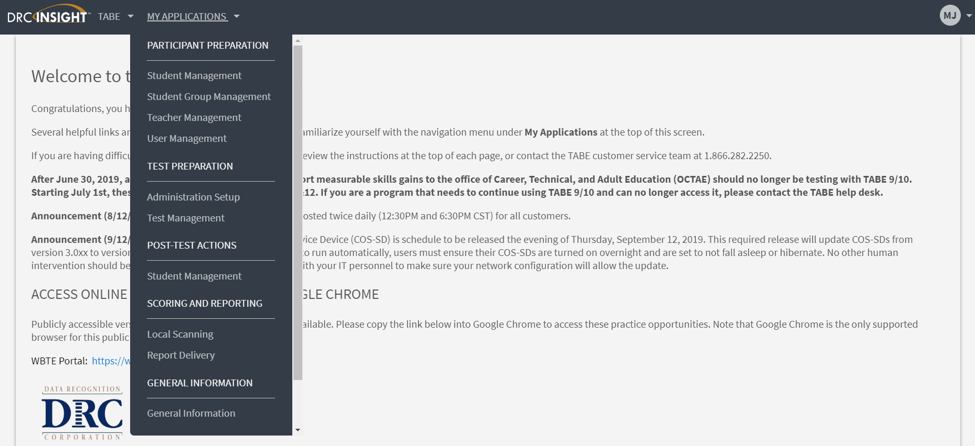
New TABE Online Interface

Slide 15
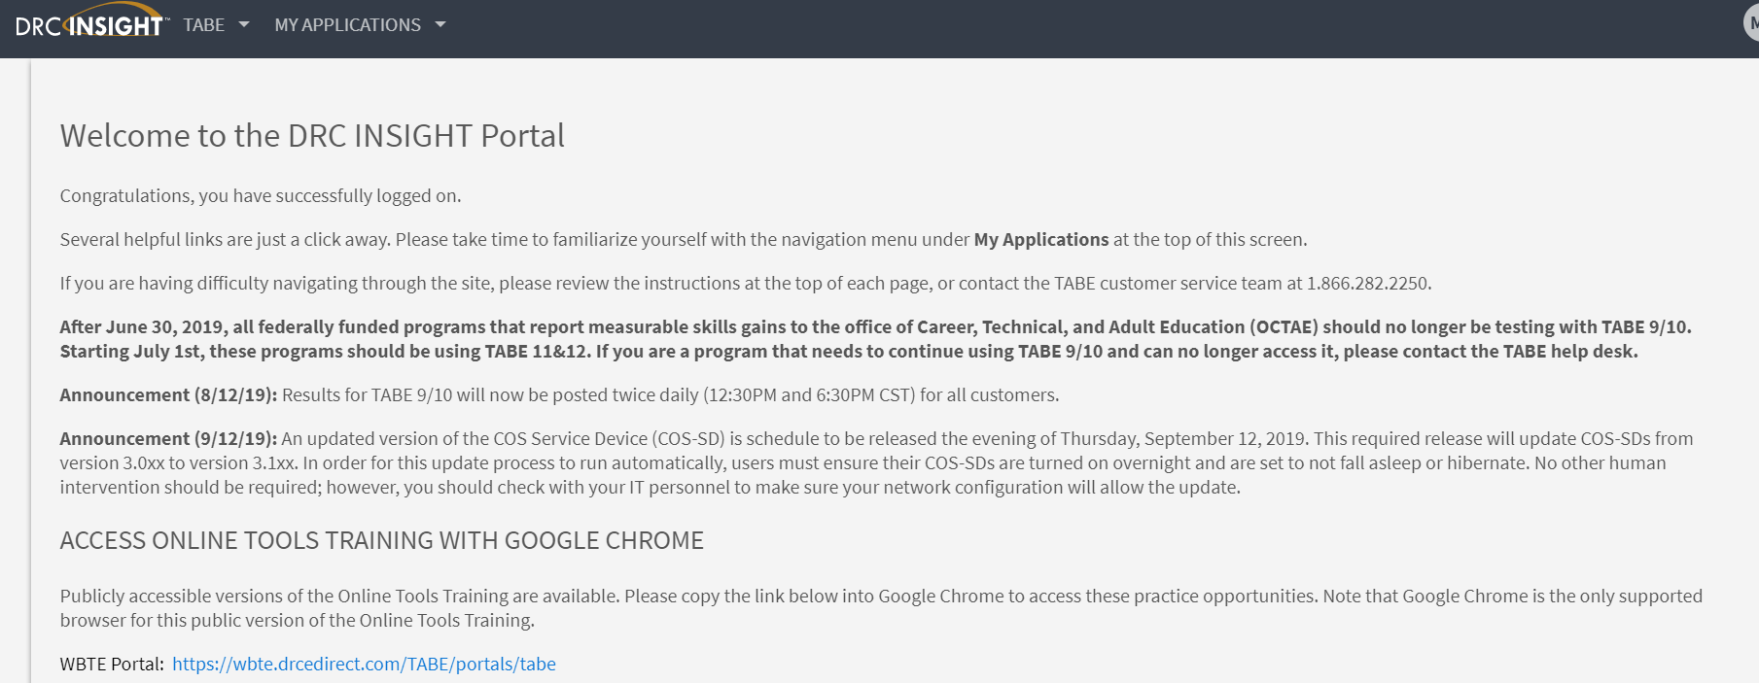
Updates and Messages on Home Screen

Slide 16
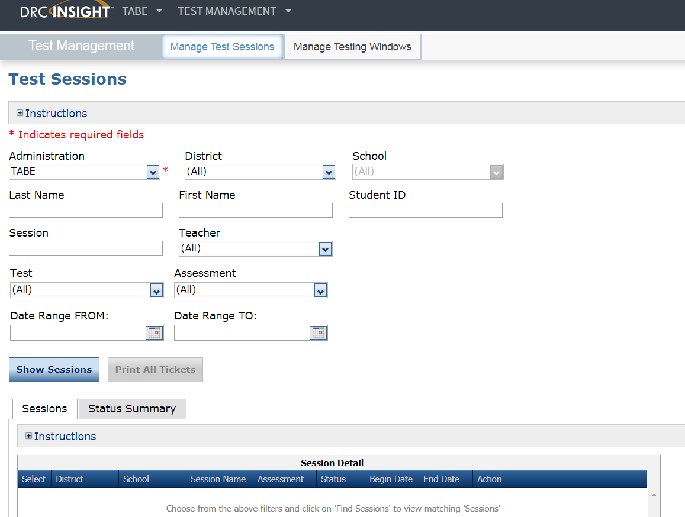
Test Sessions for TABE Online

Slide 17
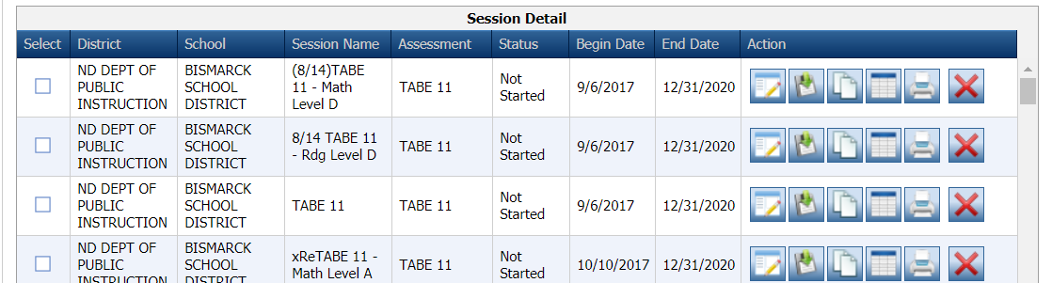
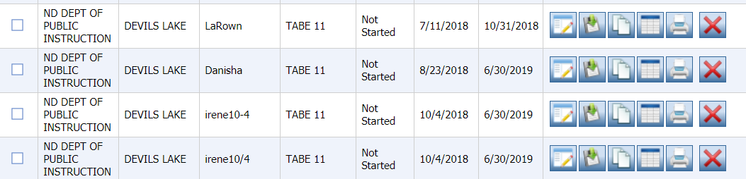
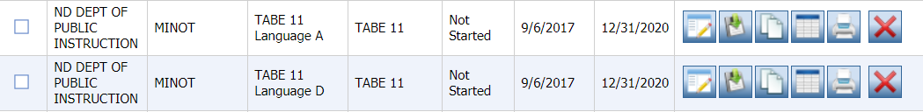
Test Session Names

Slide 18
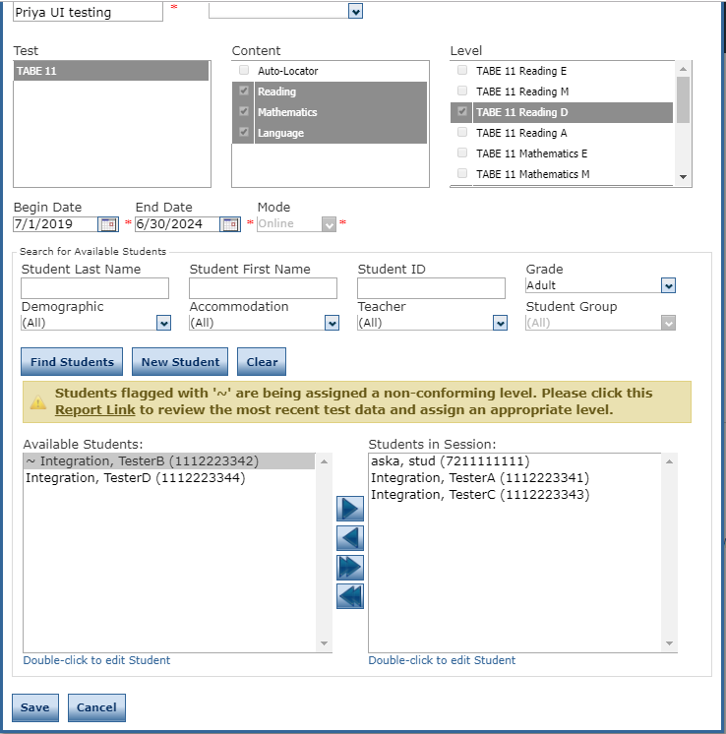
Next Recommended Test Level

Slide 19
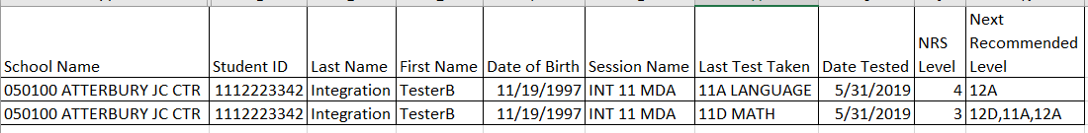
Next Recommended Test Level

Slide 20
TABE Scanning and Scoring
  Web-based; no TestMate software required
  Scanning can be done on plain-paper scanners (examples)
    Epson WorkForce ES-200
    Epson WorkForce ES-300
    Epson WorkForce ES-400
    Epson WorkForce ES-500
    FUJITSU Document Scanner fi-7160
    Brother ImageCente ADS-2800W
  Dual read, Continuous feed, TWAIN compliant
    Future enhancement: Office Copy Machines
  All Data stored in the TABE Database also used by TABE Online
Notes:
Demo Scanning Process if Time allows
TABE 11/12 switched from Scantron OMR scanners that usually cost $4,000-$5,000 to Image based scanners that generally cost $150-$850
No TestMate Software is required ($3,500 in the past). Customer that want to scan answer sheets will request access to the TABE Portal from Customer Service at no charge.
This is a list of some sample scanners
Dual Read (Duplex) and Continuous feed (auto feed) are key words. Your flatbed home office scanner will not work.
All TABE data will now be in one single database. This allows us to export to CSV files and also to start communicating to state databases to transfer data and eliminate data entry for NRS tracking.

Slide 21
TABE Reports
  TABE 11&12 Individual Profile
  TABE 11&12 Individual Portfolio
  TABE 11&12 Locator Report
  TABE 11&12 Bulk Export (state-level option)
  TABE 11&12 Roster Group Report
  TABE 11&12 Local Exporting (local option)
  TABE 11&12 Individual Diagnostic Report (Summer 2019)
    Add number points to bottom of page 1
    Customize deficient skills on pages 2 and 3 for each student
Notes:
Mention that all reports are available for programs that use both TABE Online and Scanning.
Discuss Report updates and show draft examples on next slides
Profile is the main report
Portfolio is a summary of all tests a student took
Bulk Export is starting in Michigan where we send a file to the state each night to enter into the data system.
Local export allows a program to export to excel

Slide 22
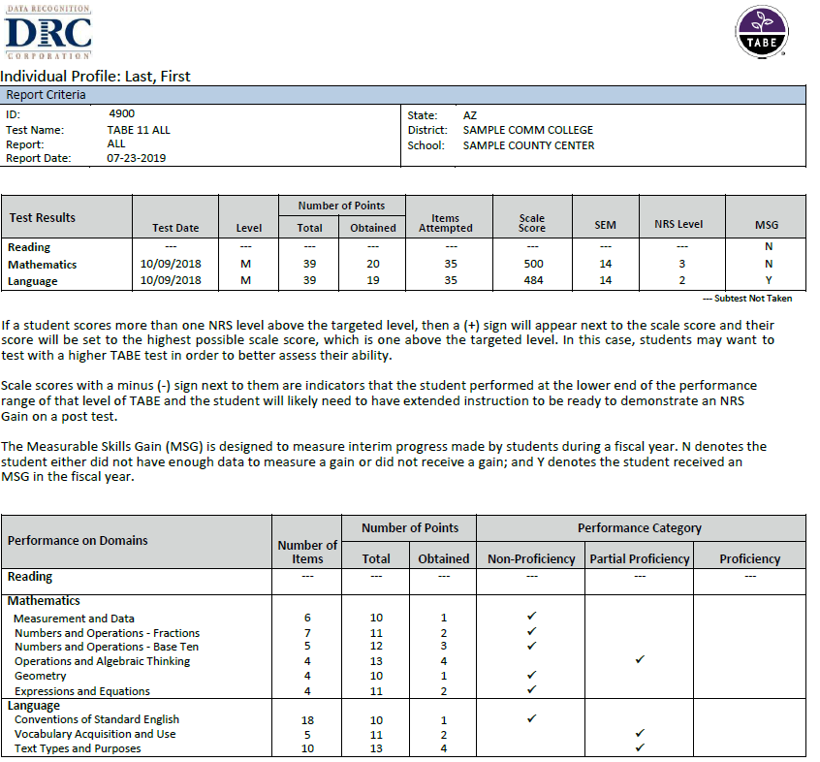
Notes:
Mock up of new Profile Report. Purple color is only a mock up and likely won’t last.
The Red box is new as of last week it is Phase one of a 3 phase update for the reports.
We have added the point detail to each of the domain areas (from the Blueprints) to the reports.

Slide 23
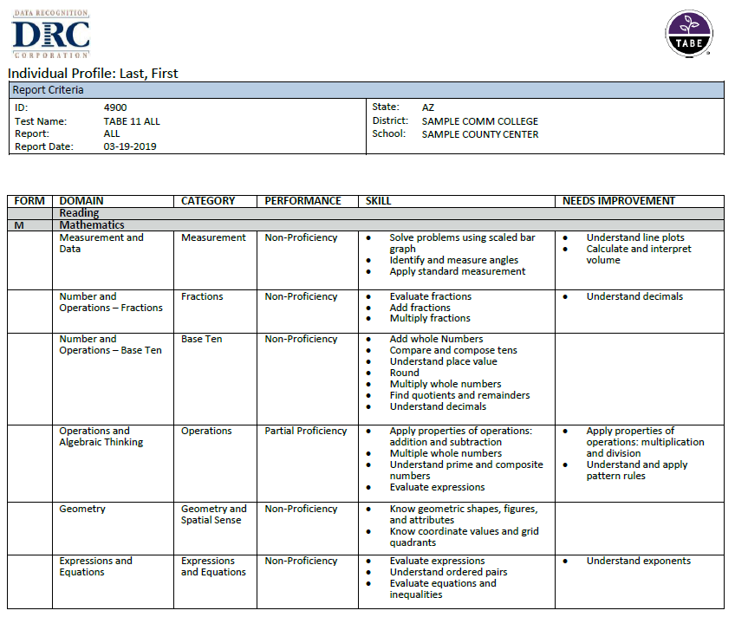
Notes:
The Red box here is Phase 2 and will be out late Summer/Early Fall. It makes the Page 2 and 3 parts of the Profile report specific to each students Skills and Areas of Inmprovement.

Slide 24
TABE and College Placement
  TABE is fully-aligned to the College and Career Readiness Standards (CCRS)
  Upper levels of TABE were designed to support a pathway to college readiness
  Is it necessary to assess students with a different placement exam when TABE can provide accurate diagnostic information for college placement?
    TABE can help support a path that successfully places students and ensures they are college ready
    TABE assesses the same content areas as other widely-used placement assessments
    We are beginning our research study for the use of TABE and its equivalency to passing scores on ACT/Accuplacer
24
Notes:
One of 2 studies underway at the request of several states this one is to align/correlate TABE 11/12 to college Placement tests like Accuplacer and ACT. Several Community Colleges (KCTCS, Louisiana, Alabama, Hawaii) used TABE 9/10 and old correlations and they have asked us for new correlations. We are activly looking for data of students that have taken TABE 11/12 and then gone on and taken placement assessments.

Slide 25
TABE and High School Equivalency
  TABE and High School Equivalency (HSE) Tests are fully-aligned to the College and Career Readiness Standards (CCRS)
  TABE Level A was designed to support a pathway to High School Equivalency
  In states where adult learners are tested multiple times, is it necessary to require all subjects of a High School Equivalency test where TABE is being used?
    We believe TABE can help support an alternate path to fulfill those state requirements
    Depending on the level of TABE, states using this assessment have already assessed many of the same content areas and standards
    We are beginning our research study for the use of TABE and its equivalency to passing scores on TASC or other HSE tests
25
Notes:
Second Student also requested by states is to correlate TABE 11/12 Level A and likely Level D Reading and Math scores to Reading and Math scores for all 3 HSE tests. Several States (NY, Louisiana, Mississippi, Missouri) have or are working on alternative pathways for HSE and they want to know what TABE 11/12 score is equivalent to a passing score on HSE tests so they can accept the TABE score in place of that section of the HSE requirement.

Slide 26
Thank You!
Mike Johnson
mjohnson@datarecognitioncorp.com
866-282-2250 TABE Support
tabetest.com
26

